Slide 1
Programming The Hardware
Dr. Steven Swanson
CSE176e/276e
swanson@cs.ucsd.edu

Slide 2
Take Care of the Equipment
The remote and FCB are loaned to you.
Take care of them!!!
If you break them through neglect or abuse or loose them, you must pay for their replacement/repair.
If you want to build your own remote, talk to me.

Slide 3
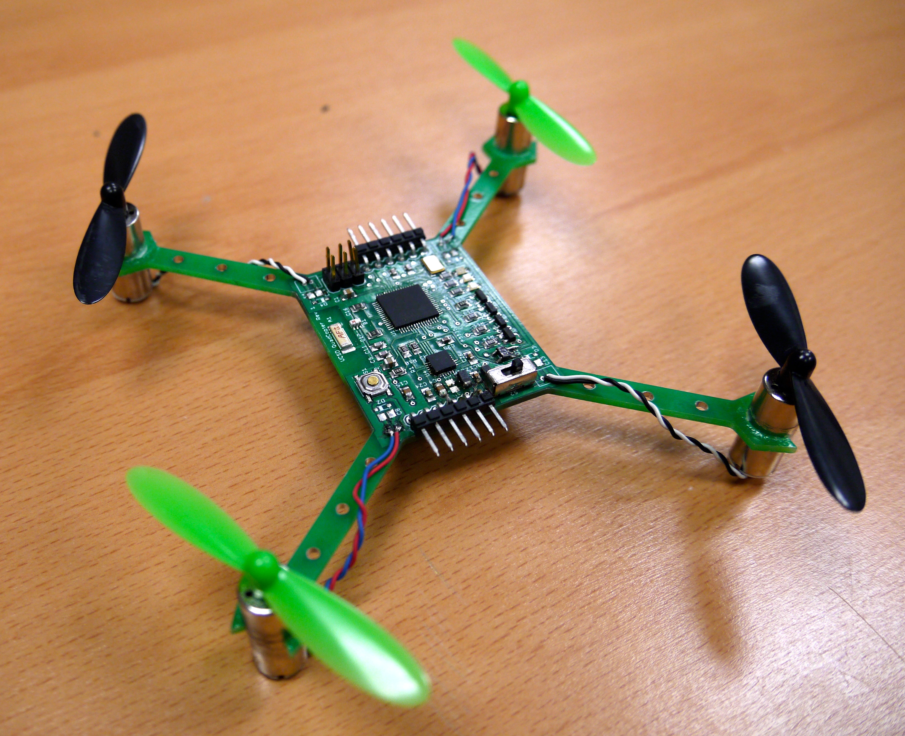
The Hardware You will Build

Slide 4
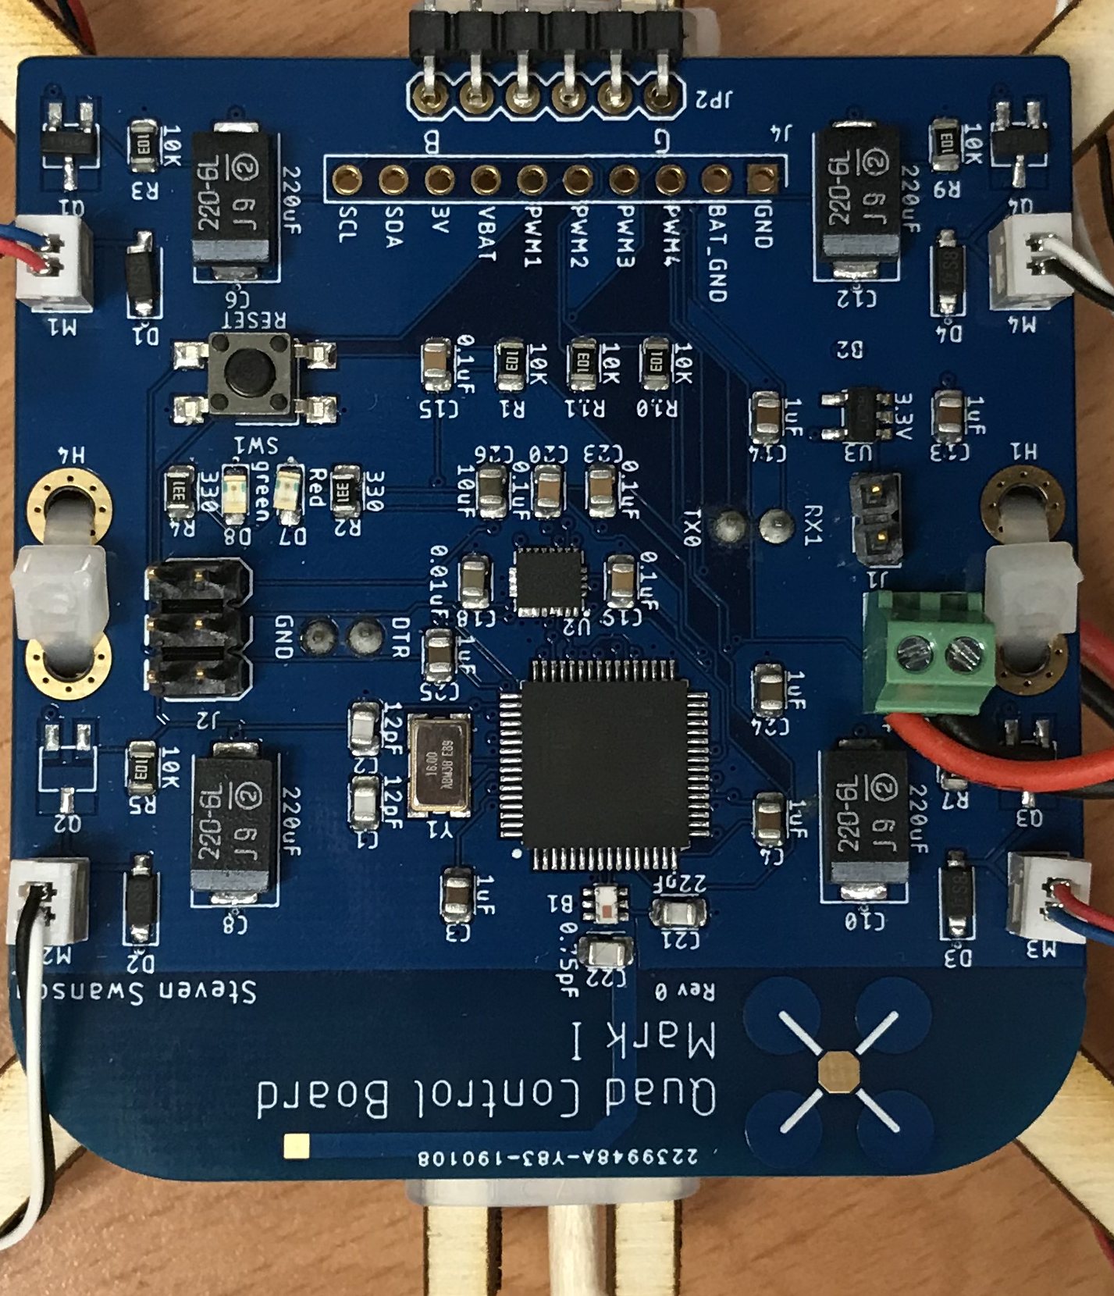
The Hardware You Will Build

Slide 5
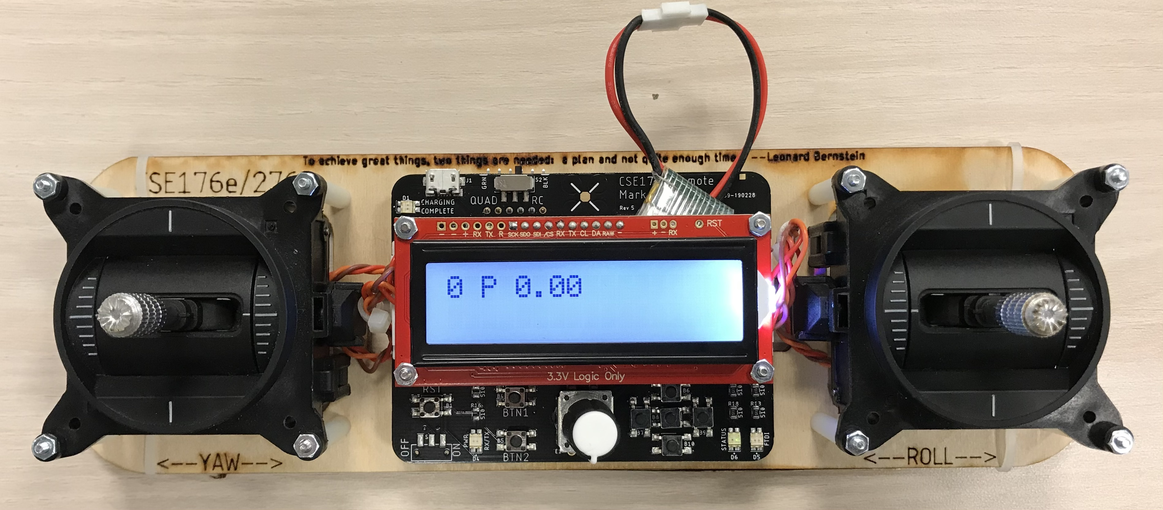
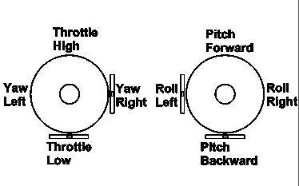
Controller
Read user input for flight
2 ”gimbals”
Left: throttle and yaw
Right: pitch and roll
Yaw, pitch, and roll are spring-loaded to return to neutral
Throttle stays where you put it.
Buttons and a knob for tuning
A radio for communication
A battery charger

Slide 6
Programming the Remote and FCB
The remote has a built-in USB-serial converter that works with Arduino.
It has two modes
RC mode – programs the remote
Quad mode – Sends programming signals via header.
To program FCB
Connect FCB to remote with 4-strand cable
Match ‘B’ to black wire and ‘G’ to green wire.

Slide 7
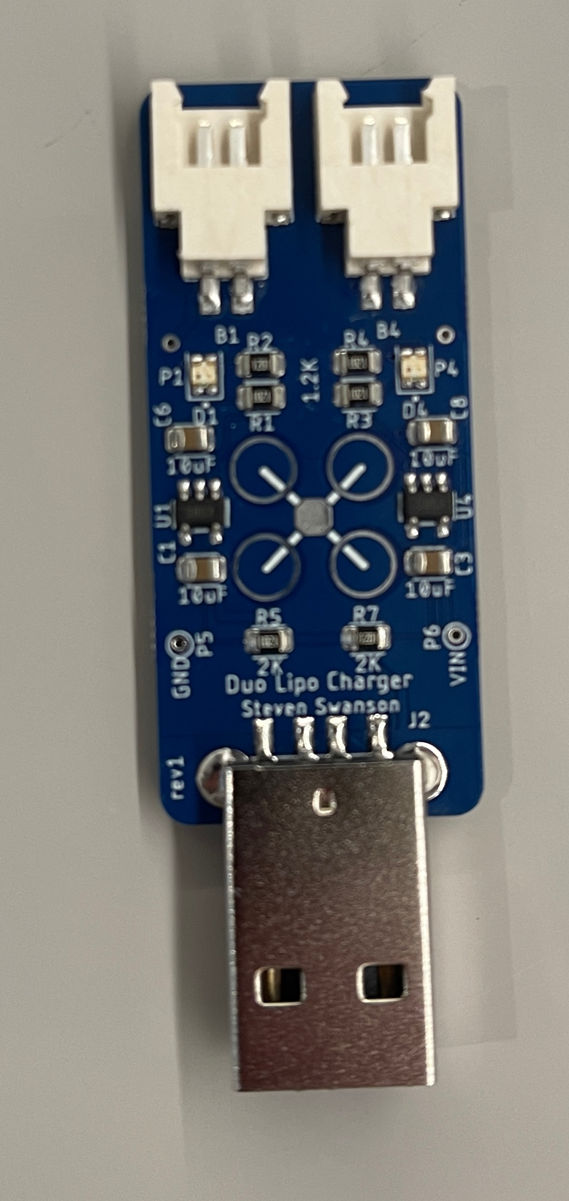
Powering the FCB
The FCB is powered by its battery.
There’s no power switch. Unplug the battery.
The FCB runs through batteries quickly
Keep your remote plugged in and charging.
Keep your battery charger charging.
Swap when FCB battery get low (i.e., it starts resetting when you turn on the motors)

Slide 8
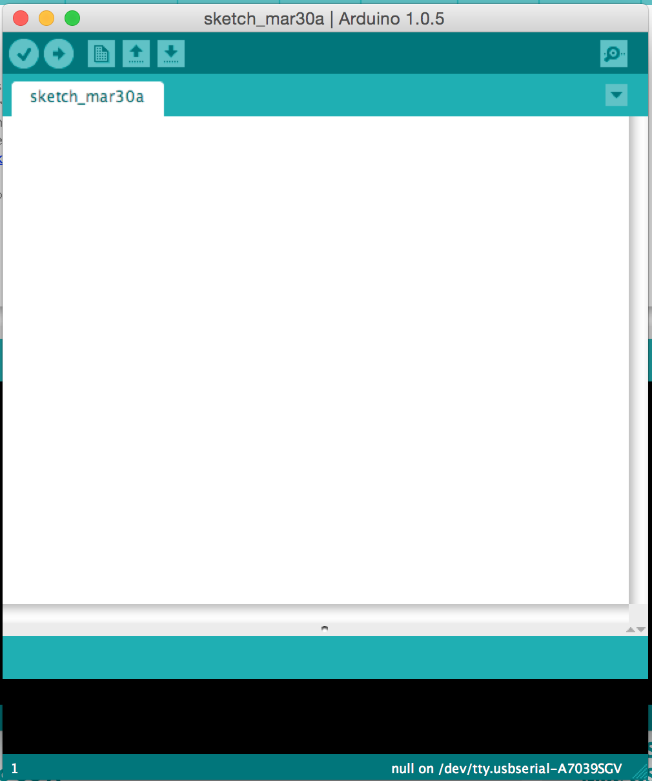
The Arduino IDE
User-friendly IDE for Arduino programming
Programming the microcontroller is easy
Installation is easy
Settings
Tools->Board->Quad Class Atmega…
Tools->programmer->USBTinyISP
Tools->Port->Com n (windows, choose largest n available)
Tools->Port->cu… (pick the one that appeared when you plugged in the remote)

Slide 9
Software Plan
This Lab
Meet the hardware
Learn to use it
Sensing Lab -- IMU Filtering
PID Lab -- Implement control
Do everything on the Test Stand first, then move to your quadcopter

Slide 10
Quadcopter Firmware
Sensing
Use the IMU to measure the orientation of the quadcopter
Filter IMU readings to eliminate noise
Control
Based on IMU measurements, maintain stability
Receive commands from remote
Implement them

Slide 11
Remote Firmware
Control
Measure gimbal position
Transmit readings to the quadcopter
Tuning
Your control algorithm will have many parameters
You’ll need to tune them in real time
Use the knob and buttons to make this easy
or don’t… and suffer the consequences (extreme tedium and slow progress on tuning)

Slide 12
Lab Tasks
Use everything
Install IMU library. Read values from IMU.
Read the values from the gimbals.
Drive the motors.
Read values from the knob and buttons.
Build remote-controlled motors
FCB drives motors.
Remote control reads gimbals and transmits value to run motor at.
This is the basic framework for your quadcopter and remote firmware.

Slide 13
The Hardware

Slide 14
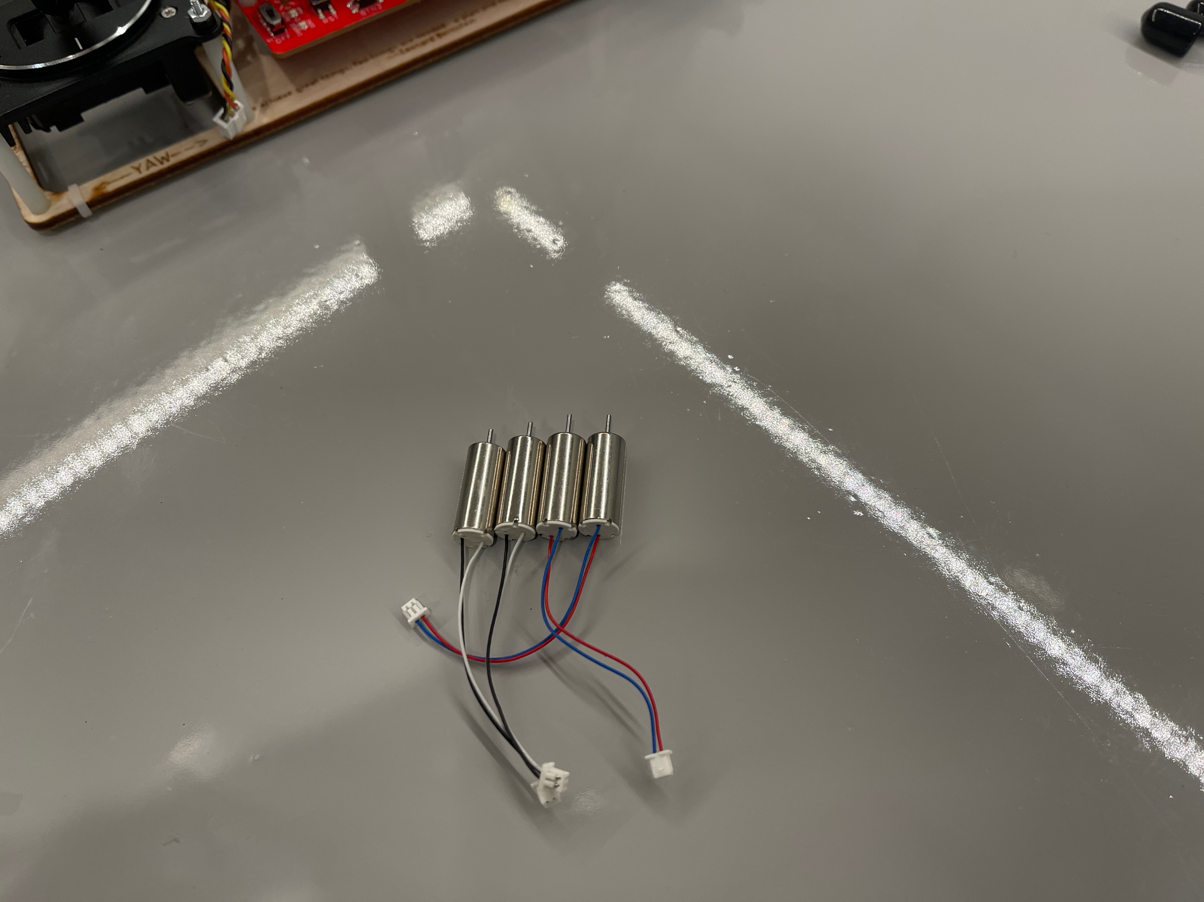
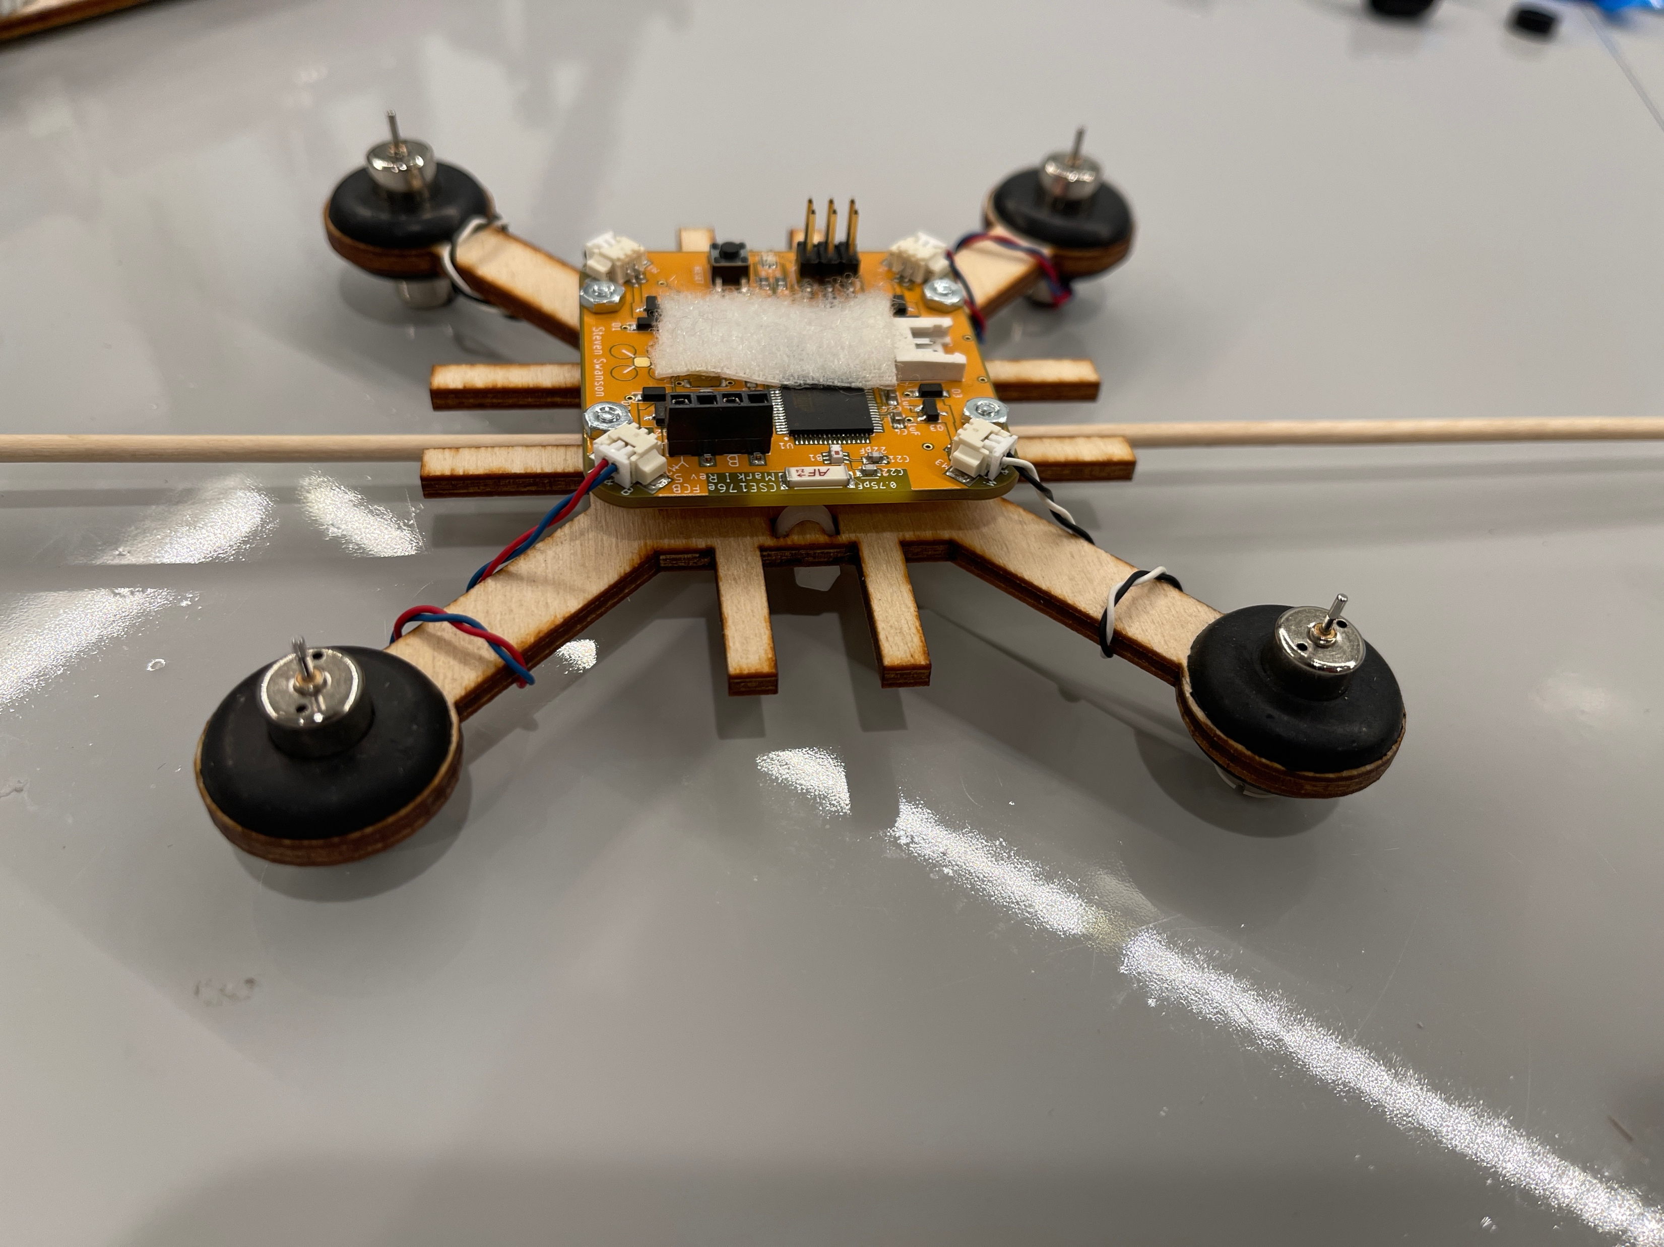
Brushed Motors

Slide 15
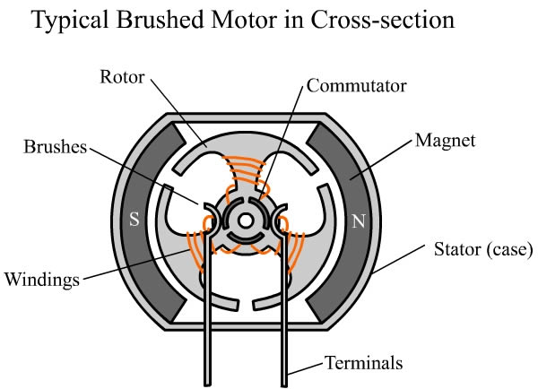
Construction

Slide 16
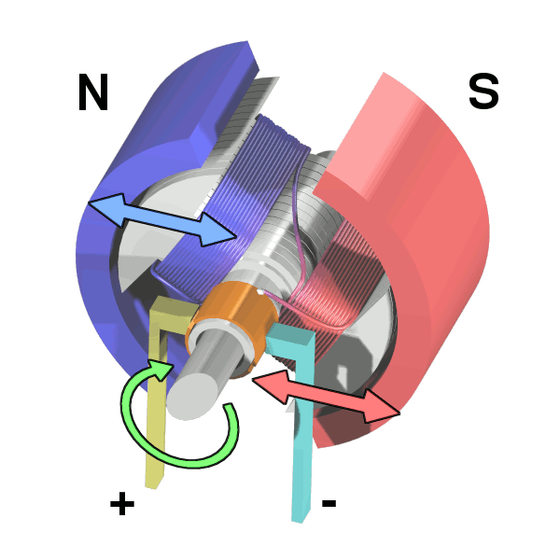
Operation

Slide 17
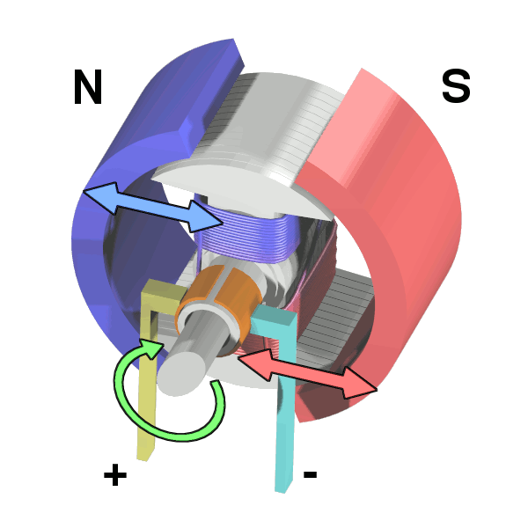
Operation

Slide 18
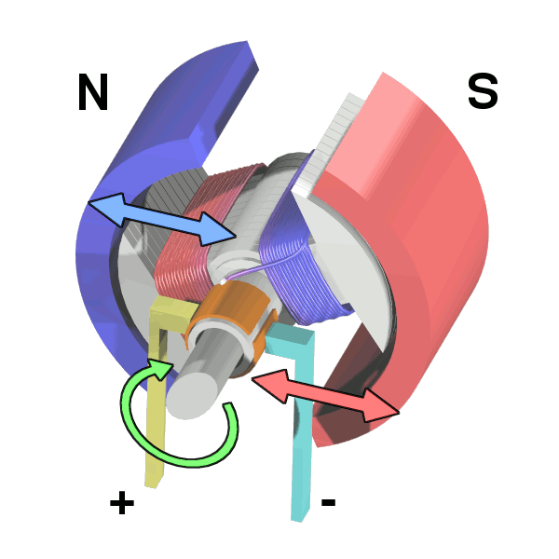
Operation

Slide 19
Operation

Slide 20
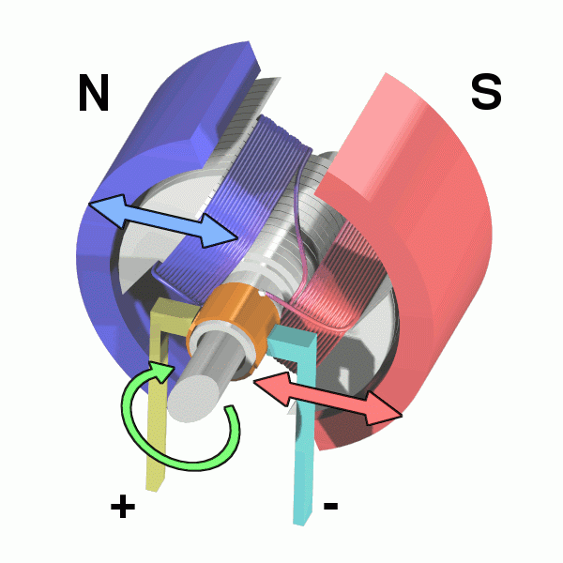
Operation

Slide 21
Controlling Brushed Motors
Speed ∝ Voltage ∝ Current
Vary the input voltage
Generating varying voltages is non-trivial.
You need a digital-to-analog converter
Really, we just need the average voltage to vary

Slide 22
Pulse Width Modulation
PWM varies the average voltage using a digital signal
Duty cycle: % of time signal is high
Cycle time: delay between rising edges (~2ms on our MCU – 490Hz)

Slide 23
PWM in Arduino
The motors are connected to the FCB via analog output (PWM) pins
analogWrite (int pin, int v)
‘v’ is the duty cycle (0…255)
‘pin’ is the the pin

Slide 24
Gimbals

Slide 25
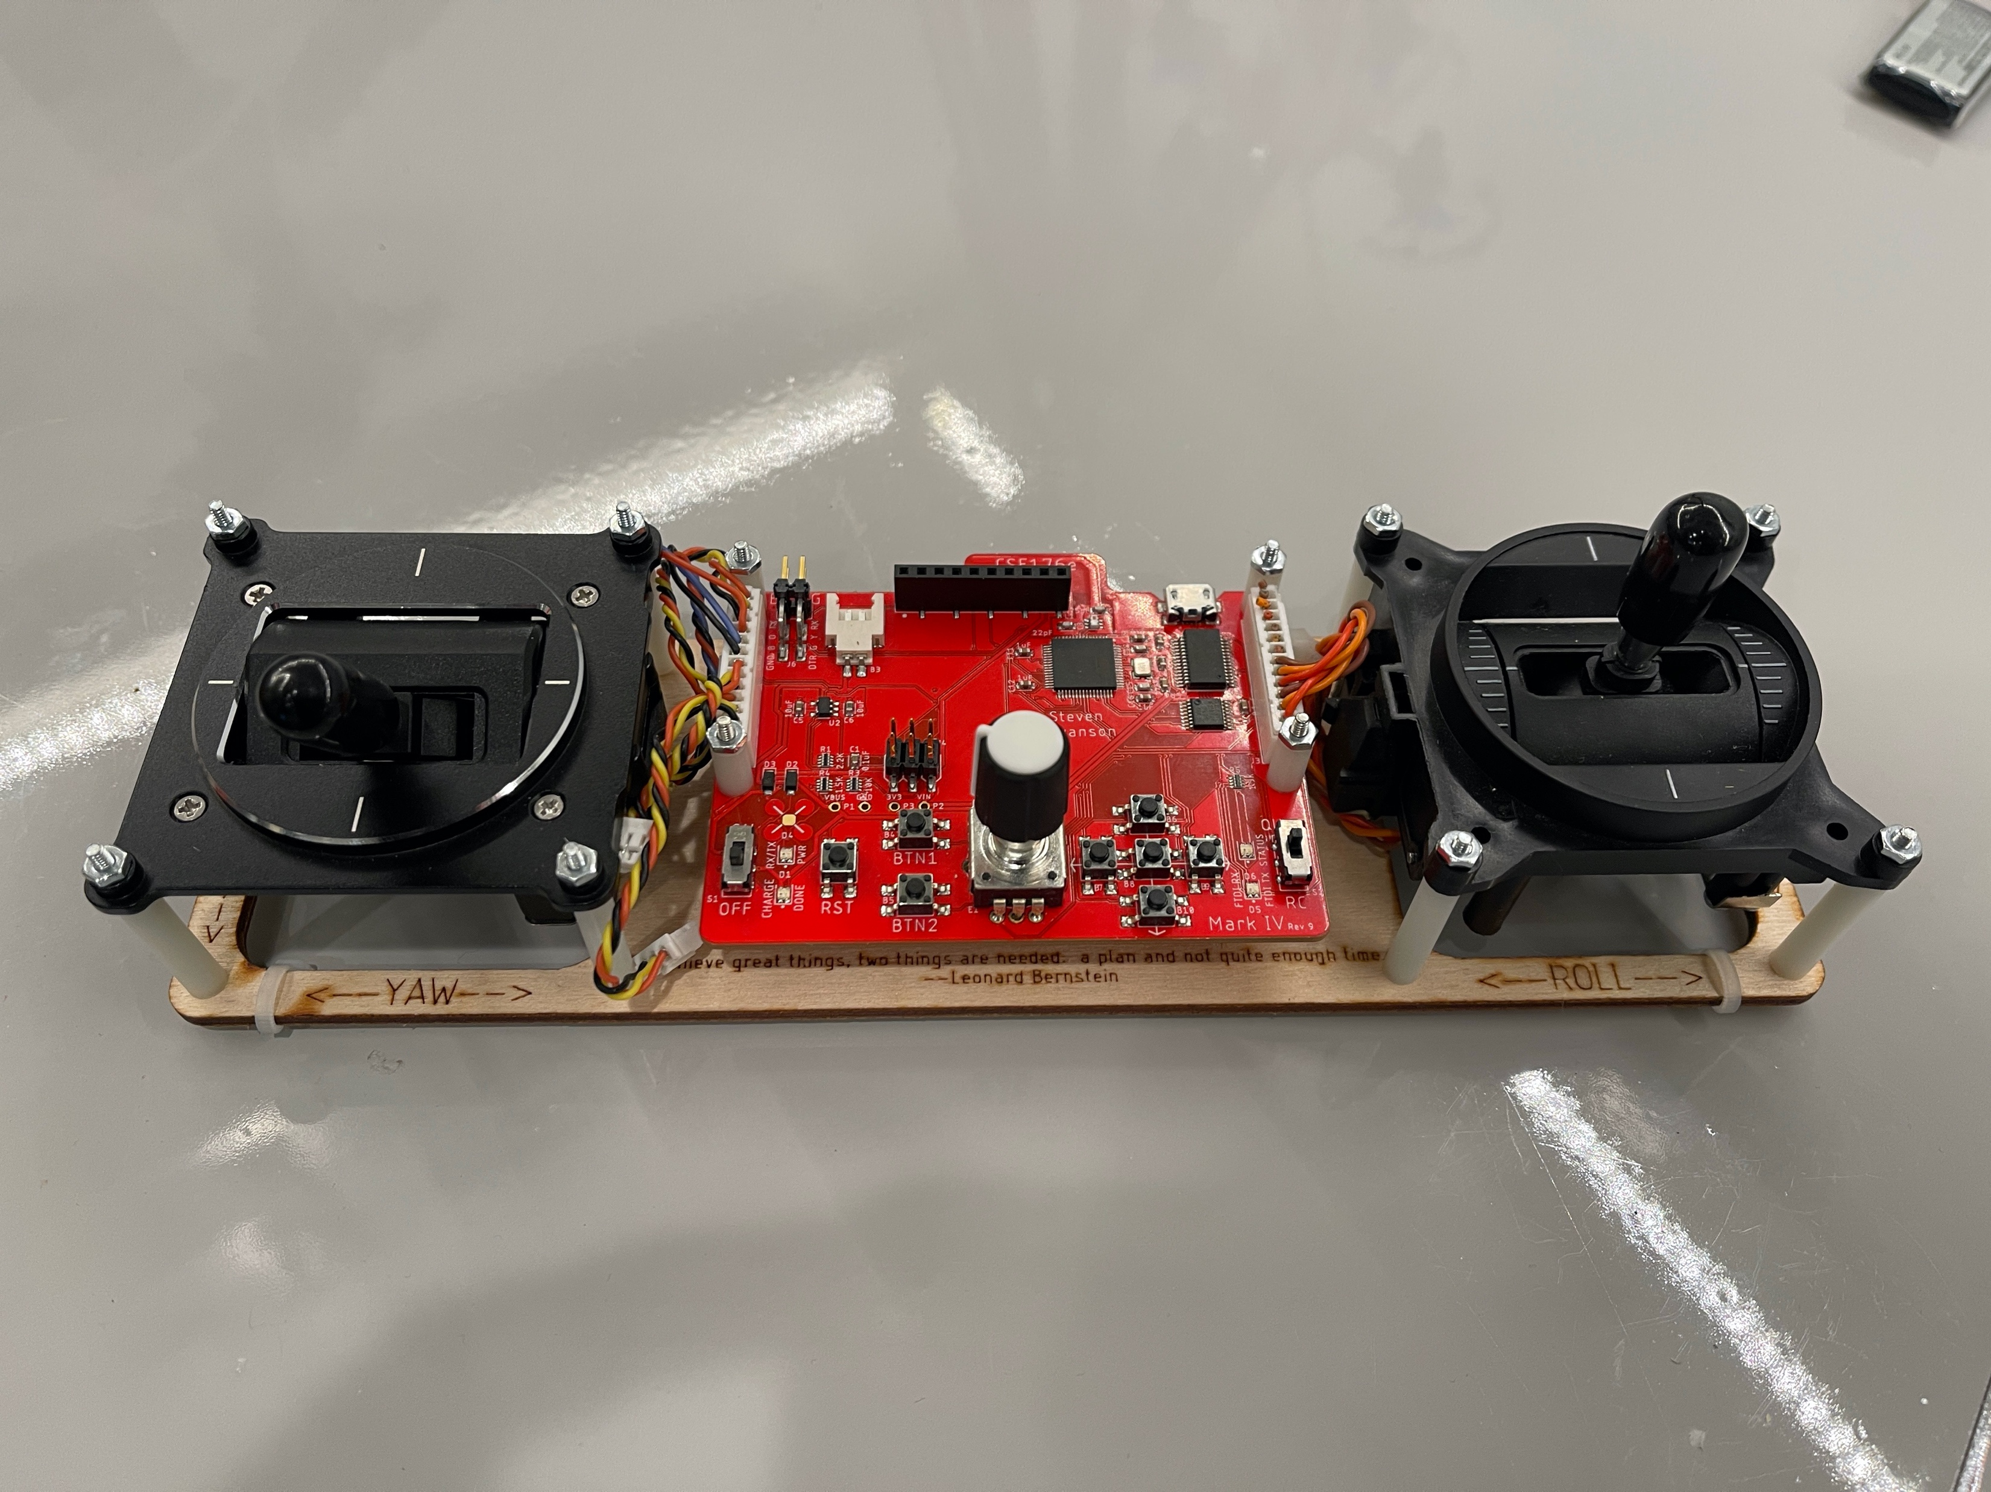
The Gimbals
Each stick is a “gimbal”
a mechanism, typically consisting of rings pivoted at right angles

Slide 26
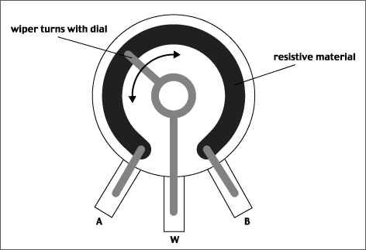
Anatomy of a Gimbal
Two potentiometers measure X and Y movement of the stick.
Potentiometer – A variable voltage divider
As the slider’s movement changes the resistance from A and W and W and B.
The voltage at W is proportional to the position of the gimbal.
In reality, the resistances are always > 0, so W never reaches VCC or GND.
Our gimbal
Frsky PR10
Total resistance: 2.4KOhms
Rated voltage: 5V

Slide 27
Reading the Gimbals
The gimbals are connected to analog input pins on the MCU
analogRead(int pin)
Takes a voltage between GND and Vcc and maps it to 0—1024
The Remote library defines constants for which pins to read.
firmware/libraries/Remote/quad_remote.h

Slide 28
Status LEDs
The remote has 2 status LEDs
They are useful for letting you know when the quad is armed, etc.
Use digital_write() to control them.
See quad_remote.h for pins

Slide 29
Buttons
The remote has 7 buttons.
1 ”D-pad” – up, down, left, right, center
2 others (btn1, btn2)
The Remote library has two interfaces
Call-backs: A function that is called when a button is pressed.
is_pressed(): Check if a button is currently pressed.
Potential problems
Sometimes one press appears as several due to “bouncing”

Slide 30
Rotary Encoder
The knob is ‘rotary encoder’
It can turn indefinitely in either direction.
The Remote library tracks its movement
Query current value with: knob1.getCurrentPos ()
Set current value with: knob1.setCurrentPos()
The knob also has a built-in button. It works just like the others.

Slide 31
Radio
The remote and FCB (and your quadcopter) all use the same radio.
The ‘Radio’ library provides access.
There are 11 channels
Eaglint will allocate your team a channel when you create your group.
Since you are at home, the channel doesn’t matter that much. You can use whatever you like. Some will be noisier around your house than others.
It’s not private, so you must share nicely – don’t transmit constantly
Set your channel with: rfBegin(WIRELESS_CHANNEL);
Send data with: rfWrite(<data>)
Receive data (if available) with : rfRead(<data>)

Slide 32
Radio: What To Send
You must define the packet format for your remote/quad.
The easiest thing to do is define a struct that has everything you need.
It can be up to 128 bytes (I think)
You must send the data you need
You must reject packets from other sources (noise and other teams)
Include a ‘magic number’, unique to your team
Include a checksum (highly recommended)
Always check the length of the data you read (it should match the size of your struct)

Slide 33
Remote Software Path
Scale and bound gimbal readings
P, Y, R: -128 to 127
T: 0 to 255
Tuning parameters
Set tuning parameters with the UI
Send them to the quadcopter
Transmit updates at 10-20Hz.
No faster – share the spectrum!

Slide 34
Quadcopter Datapath for This Lab
Read the throttle
Control the motors

Slide 35
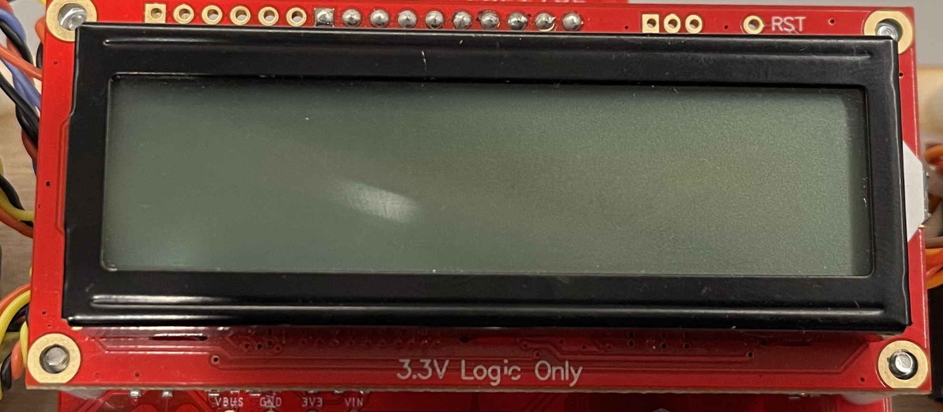
LCD
The LCD can provide feedback to the pilot.
UI for calibration and tuning
The Remote library defines an object called `lcd`
You write to it just like a serial port.
Some other operations too.
See lab and examples.
It has a RGB backlight ☺

Slide 36
Remote Controlled Motors

Slide 37
Arming the Quad
Your motors should not turn on accidently (e.g., by default, if the throttle happens to be on, if you bump the throttle) – it’s dangerous
You firmware must support ”arming” the quadcopter
Push the gimbals out and down (left to lower left, right to lower right)
Forces throttle to zero.
Unlikely to happen by accident.
Turn on an LED on the FCB when it is armed.
Turn off the LED when it’s disarmed.
Resetting the remote or the FCB should disarm both.

Slide 38
Calibration
The actual range of values from your gimbals will vary.
You need a consistent range to control your quad.
Your remote needs a calibration mode where it learns the actual range
You should map the actual range to (0-255) for throttle, and (-128 to 127) for everything else
Requirements
Calibration mode should only be available when the FCB is disarmed
You must save the calibration measurements in the MCU’s EEPROM (see lab for details)
You must provide some feed back via the LCD so the user knows what’s going on.

Slide 39
Demo
Walk through knobs_and_buttons.ino
Demo solution

Slide 40
Form groups
This lab (and all future) are in (the same) groups of two.
Create group on eaglint
Create group assignment on github classroom
Use exactly the same name!

Slide 41
Assemble the Remote and Test Stand
Come up and get a kit.
Get started.
Instructions are and photos are in the lab.
There’s a video online.

Slide 42
The End

Slide 43
Assembling the Quadcopter and Remote
Dr. Steven Swanson
CSE176e/276e
swanson@cs.ucsd.edu

Slide 44
Programming The Hardware Lab Checklist Demo
Dr. Steven Swanson
CSE176e/276e
swanson@cs.ucsd.edu

Slide 45
Next Time
30 minutes of questions
70 minutes of lecture
They completed assembly of the remotes and test stands in 1-2 hours.

Slide 46
Maintaining Stability
Multi-rotor aircraft are inherently unstable
Mismatched motor power (voltage variation, manufacturing variation in motors or props)
Variation in air currents and density.
Once perturbed, there’s no force acting on the aircraft to return it to equilibrium.

Slide 47
Maintaining Stability
Multi-rotor aircraft require a closed loop controller
Sensors detect aircraft movement and orientation
Controller adjusts the power to motors to maintain desired location and orientation
Multi-rotor aircraft use a few sensors to maintain stability
Accelerometers (absolute pitch and roll)
Gyroscopes (changes in pitch, roll, and yaw)
The flight computer implements the control algorithm
Usually a proportional, integral, derivative (PID) controller implemented in software.
We will talk more about this later.
With PID controllers for pitch, yaw, and roll multirotor aircraft can achieve stable flight.

Slide 48
Higher-order Navigation
Large multi-rotor aircraft can do more
Maintain geographic position
Maintain altitude
Follow an prescribed/pre-programmed path
More sensors required
Magnetometers (absolute yaw or heading)
GPS (absolute location and altitude)
Barometers (altitude)

Slide 49
Demos
Show PWM signal changing duty cycle
Show flyback
Effect of diode
Show effect on power supply noise
Show filter on pwm line
Effect of resistor and capacitor on PWM
Show output of FET
Show affect of filter on power supply noise

